Slide 1
Agile Overview and Ceremonies

Slide 2
Agenda
What is Agile?
Backlog
Backlog Grooming
Planning Poker
Capacity & Sprint Planning
Daily Scrum
Daily Scrum Overview
Sprint Review & Retrospective
Scrum of Scrums
What is Scrum of Scrums?
Roles and Responsibilities
Questions?
Contact Us

Slide 3
What is Agile?
The dictionary defines “Agile” as something that quickly adjusts to change.
In our world, “Agile” is an iterative project management framework that is based on the Agile manifesto and 12 Agile principles. The framework embraces unpredictability of long term initiatives while promoting transparency, accountability, and continuous improvement.
This includes:
A Group of Methodologies: Such as Scrum, SAFe, Kanban, XP, etc.
Iterative Processes: 3 month builds with 1 - 4 week Sprints
Cross Functional Teams: Members leverage each other’s skill to meet project objectives
Collaborative Environments: Team, Stakeholders, and Leadership all participate in the process
Value-Driven Delivery: Deliver high-priority functionality first (items with highest ROI)
Continuous Improvement: Each iteration includes an opportunity to learn and improve

Slide 4
What is Scrum?
Scrum is the most widely known and used Agile methodologies. It focuses on:
An iterative approach to project completion
Detailed definition of near-term work with less elaboration of long-term work
A highly involved and engaged team
Incremental delivery of working software
Flexibility to adjust to changing needs

Slide 5
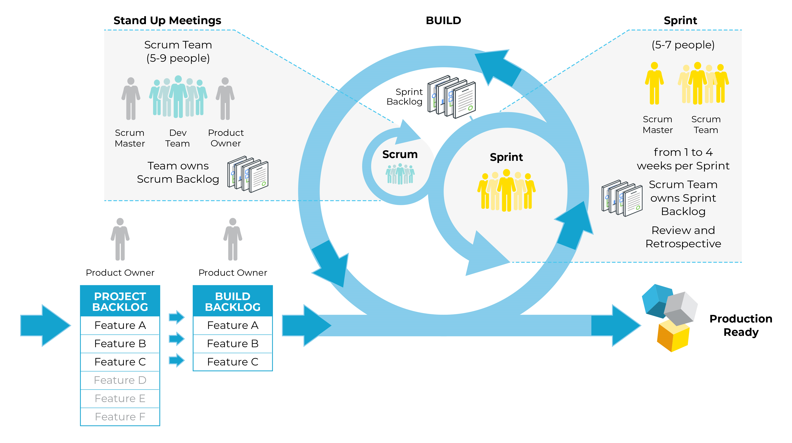
Scrum In A Nutshell
4
Notes:
Scrum is an Agile framework that emphasizes a Team based collaborative structure in order to facilitate the shared completion of business goals
Scrum operates on fixed length iterations, called sprints, and uses specific roles, ceremonies, and artifacts to ensure a product increment is produced every sprint cycle
It’s okay if this looks overwhelming. It will make more sense at the end of today.

Slide 6
Backlog Grooming

Slide 7
What is a Backlog?
What is a Backlog?
A continuously prioritized list of functional and non-functional project requirements, features, defects, and work items
Purpose:
Provides insight into project vision and focus
Displays priority and effort for each requirement
Used to communicate customer needs between Team, Customers, and Stakeholders
Benefits:
Allows for long term planning and the ability to identify risks early
Single repository for requirements
Provides Team direction by prioritization
Constantly inspected and adapted to reflect current customer needs

Slide 8
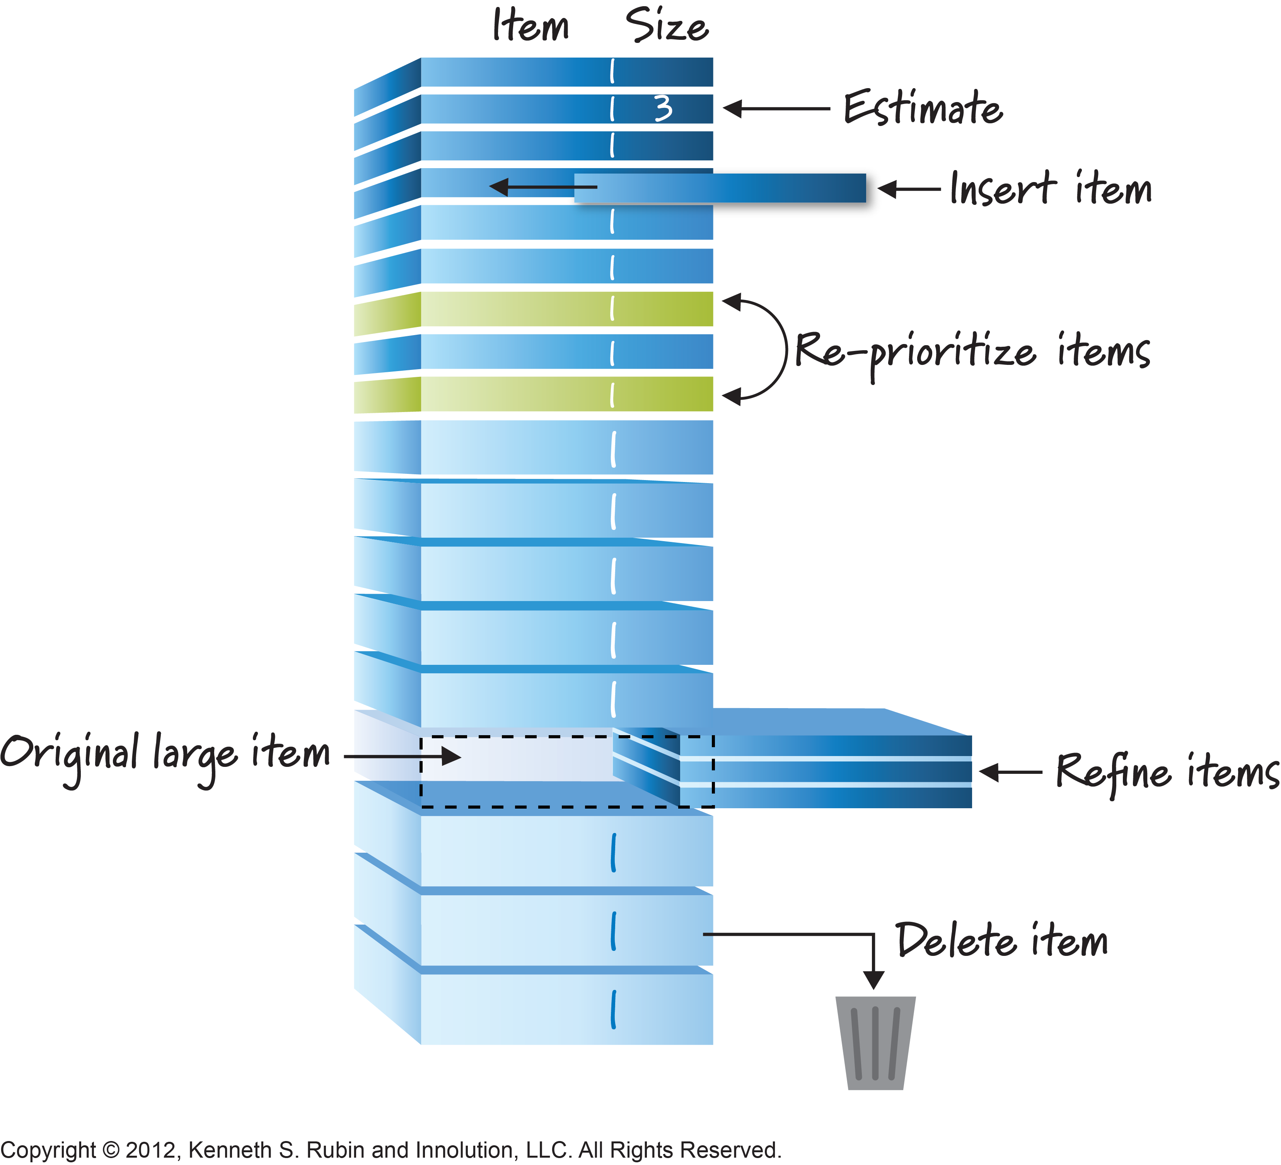
Backlog Grooming
Meetings where the Product Owner and Scrum Master groom the backlog, along with available members of the Product Team
Grooming may include the following:
Adding items
Removing Items
Changing Priority
Changing Acceptance Criteria
These meetings occur throughout the project within a sprint
Can be planned ahead of time or can be planned on as need basis requested by the Product Owner

Slide 9

Planning Poker
A technique for estimating the complexity, level of effort,
and risk inherent in a User Story
Estimates follow the Fibonacci sequence
How does it work?
Product Owner presents the highest priority user story to be included in the Sprint Backlog
Team asks questions and gets clarity from the Product Owner
Each team member simultaneously submits their story point vote
High and low estimates are discussed and a re-vote takes place
The process continue until a consensus is reached
Once a consensus is reached, the story point is assigned to the User Story. The process is repeated for each User Story

Slide 10
Capacity & Sprint Planning

Slide 11
Capacity Planning
An activity held in preparation for Sprint Planning to:
Determine max amount of hours each Team member has available to complete work within a Sprint
Ensure the Team does not take on more work than is reasonable
Determine a realistic work schedule for the Team
Account for external commitments, such as out-of-office time and outside projects
Input provided by the Team, Scrum Master, VA Project Manager (VA PM)

Slide 12
Sprint Planning
Time boxed Scrum ceremony that allows the Team to discuss and commit to the Sprint Backlog:
Attended by the Product Team, Scrum Master, VA Project Manager (VA PM), and the VA Product Owner (VA PO)
Prior to Sprint Planning, User Stories should be estimated using Story Points
Product Owner describes the highest priority User Stories and their business value
Team gets final clarification on User Stories and pulls them from the Build Backlog into the Sprint Backlog
Tasks are created and estimated
Scrum Master ensures Team is not over or under committed
Team commits to completing the now defined Sprint Backlog
The output of a Sprint Planning meeting is a Team accepted Sprint Backlog

Slide 13
Daily Scrum

Slide 14

Daily Scrum Overview
What is a Daily Scrum?
A time boxed Scrum Ceremony
Short and focused (15 min maximum)
Replaces the need for other status meetings
Facilitated by the Scrum Master
Occurs daily at the same time
Performed by the Team, for the Team
Purpose:
Report task progress
Report and remove impediments
Allows all Team members to have clarity into work being done, aiding collaboration

Slide 15
Participants
Required Attendees:
Scrum Master: Facilitates the ceremony; tracks and removes impediments
Team: Each member provides brief status including updates and impediments
Optional Attendees:
VA PM/Product Owner(s)/Business Owners/Stakeholders: May attend but are considered silent observers

Slide 16
Sprint Review & Retrospective

Slide 17
What is a Sprint Review?
A Scrum ceremony facilitated by the Scrum Master where the Team provides a demonstration of completed functionality to the Product Owner and Stakeholders for acceptance of the finished work.
Held at the end of each Sprint to inspect completed work
Present the completed backlog items to be Accepted and/or Rejected based on predetermined Acceptance Criteria

Slide 18
What is a Retrospective?
A meeting held at the conclusion of each Sprint in which the Team and Scrum Master meet to celebrate Team successes, reflect on what can be improved, and develop a plan to apply lessons learned going forward.
This is a safe environment
What is discussed in the Retrospective, stays in the Retrospective
Retrospective discussion points:
What went well?
What did not go well?
What action items are we tracking to help with improvements?

Slide 19
Scrum of Scrums

Slide 20
Scrum of Scrums
What is a Scrum of Scrums?
A 30 minute time boxed Scrum Ceremony
Facilitated by the Program Manager
Cluster of teams within a Program are represented
A representative (usually the Project Manager/Scrum Master) attends on behalf of their team
Answer four questions about the status of work from their team
Should be held at least 2 times a week
In our case, once a week since VSP does their ToT on Tuesdays

Slide 21

Roles and Responsibilities
Scrum of Scrums Attendees:
Program Manager
Facilitates the stand up
Tracks statuses, risks, and issues
Documents and removes impediments
Project Manager/Scrum Master
Provides updates from his/her Program or Team
Communicates inter-program dependencies
Informs Program Manager of impediments

Slide 22
Scrum of Scrums Format and Outputs
1
What did your team do since we last met?
Potential Outputs Addressed:
Upcoming Release Readiness
Sprint Deliverables
Sprint Progress
Product Acceptance (Sprint Review)
2
What will your team do before we meet again?
3
Is anything slowing your team down or getting in their way?
4
Are you about to put something in another team’s way?

Slide 23

Questions

